Slide 1
Input and Interaction
Chun-Yuan Lin
CG
115/11/08

Slide 2
This chapter
We now turn to the development of interactive graphics programs.
The discussion has three main parts
  We introduce the variety of devices available for interaction.
    Physical device
    Logical device
  We then consider client-server network and client-server graphics.
    Even driven input for the graphics program
  We develop a polygon modeling program that demonstrates many of these important features of interactive graphics programming
CG
115/11/08

Slide 3
Interaction (1)
One of the most important advances in computer technology was enabling users to interact with computer displays.
The user sees an image on the display. She reacts this image by means of an interactive device, such as a mouse. (the image changes in response to her input)
Interactivity is an important component of most applications. OpenGL (gl) does not support interaction directly.
CG
115/11/08

Slide 4
Interaction (2)
The GLUT toolkit provides the minimal functionality that is expected on virtually all systems, such as opening of windows, use of the keyboard and mouse, and creation of pop-up menus.
We use the term window system, to include the total environment provided by systems such as X window system.
Our use of the GLUT toolkit will enable us to avoid the complexities inherent in the interactions among the window system, the window manager, and the graphics system.
CG
115/11/08

Slide 5
Interaction (3)
We start by describing several interactive devices and the variety of ways that we can interact with them.
Then we put these devices in the setting of a client-sever network and introduce an API for minimal interaction.
Finally, we generate a simple programs.
CG
115/11/08

Slide 6
Input Devices (1)
We can think about input devices in two distinct ways.
  Physical devices as keyboard and mouse and to discuss how they work.
  Logical devices, what they do from the perspective of the application program. A logical device is characterized by its high-level interface with the application.
  int x;
  scanf(&x);
  printf(“%d”,x);
  Rather scanf and printf are logical functions that are defined how they handle input or output character strings from the perspective of the C program.
CG
115/11/08

Slide 7
Input Devices (2)
When we output a string of characters using printf or cout, the physical device on which the output appears could be a printer, a terminal, or a disk file.
In computer graphics, the use of logical devices is somewhat more complex.
Physical Input Devices
  Pointing device allows the user to indicate a position on a display and almost always incorporates one or more buttons to allow the user to send signals or interrupts to the computer.
CG
115/11/08

Slide 8
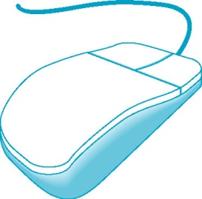
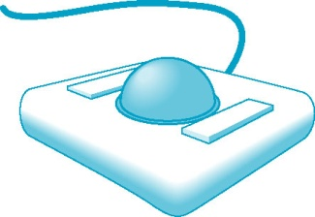
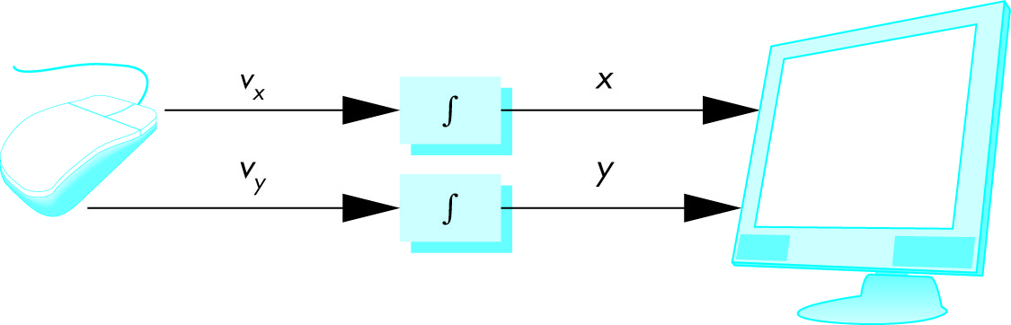
Input Devices (3)
  The keyboard device is almost always a physical keyboard but can be generalized to include any device that returns character codes.
  The mouse and trackball are similar in use and often in construction as well.
  We can view the output of the mouse or trackball as two independent values provides by the device. (two-dimensional location)
CG
115/11/08

Slide 9
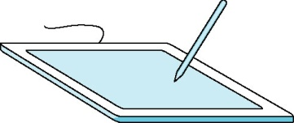
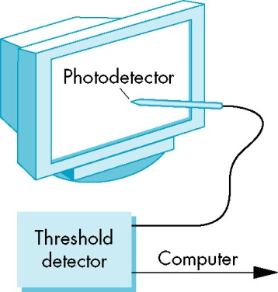

Input Devices (4)
  A mouse moves across a surface, the integral of the velocities yield x, y value that can be converted to indicate the position for a cursor on the screen.
  These devices are relative-positioning devices because changes in the position of the ball yield a position in the user program.
  Data tablets provides absolute positioning. A typical data tablets has rows and columns of wires embedded under its surface.
  The lightpen has a long history in computer graphics.
  One other device, the joystick is particularly worthy of mention.
CG
115/11/08

Slide 10
Input Devices (5)
  For three-dimensional graphics, we might prefer to use three-dimensional input devices. (none have yet won the widespread acceptance of the popular two-dimensional input devices.
Logical Devices
  We can now return to looking at input from inside the application program-that is, from the logical point of view.
  Two major characteristics
    The measurements that device returns to the user program
    The time when the device returns those measurements.
  Some earlier APIs defined six classes of logical devices. OpenGL does not take this approach.
CG
115/11/08

Slide 11
Input Devices (6)
  String---a string device is a logical device that provides ASCII strings to the user program. This logical device is usually implemented by means of a physical keyboard.
  Locator---a locator device provides a position in world coordinates to the user program. It is usually implemented by means of a pointing device, such as a mouse or trackball. (we have to do the conversion from screen coordinates to world coordinates within the programs)
  Pick---a pick device returns the identifier of an object on the display to the user program. (in OpenGL, we can use a process called selection to accomplish picking)
  Choice---choice devices allow the user to select one of a discrete number of options. In OpenGL, we can use various widgets provided by the window system. Typical widgets include menus, scrollbars and graphics buttons. Most widgets are implemented as special types of windows. Widget sets are the key element defining a GUI.
CG
115/11/08

Slide 12
Input Devices (7)
  Valuators---valuators provide analog input to the user program. (as radio boxes)
  Stroke---a stroke device returns an array of locations. (similar to multiple uses of a locator)
Input Modes
  The manner by which input devices provide input to an application program can be described in terms of two entities: a measure process and a device trigger.
  The measure of a device is what the device returns to the user program.
    The measure of a keyboard should include a single character or a string of characters.
CG
115/11/08

Slide 13
Input Devices (8)
  The trigger of a device is a physical input on the device with which the user can signal the computer.
    The trigger can be the Return or Enter key.
  The application program can obtain the measure of a device in three distinct modes. Each mode is defined by the relationship between the measure process and the trigger.
  Once a measure process is started, the measure is taken and placed in a buffer, even though the contents of the buffer may not yet be available to the program.
CG
115/11/08

Slide 14
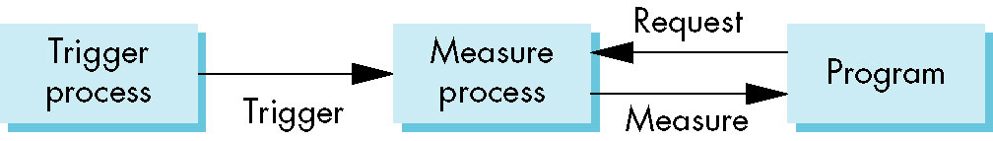
Input Devices (9)
    In request mode, the measure of the device is not returned to the program until the device is triggered. This input mode is standard in non-graphical applications.
      The data are placed in a keyboard buffer whose contents are returned to the program only after a particular key, such as the Enter key is pressed.
      For a locator, the trigger will cause the location to be returned to the application program.
CG
115/11/08

Slide 15

Input Devices (10)
  Sample-mode input is immediate. As soon as the function call in the user program is encountered, the measure is returned. Hence, no trigger is needed. (the user must have positioned before the function call)
  One characteristic of both request- and sample-mode input in APIs that support them is that the user must identify which device is to provide the input.
  Both request and sample modes are not useful in applications where the user controls the flow of the program. (multiple devices) (we do not know what devices that pilot will use at any point in the simulation) (not suitable for human-computer interaction)
CG
115/11/08

Slide 16
Input Devices (11)
  The third mode, event mode, can handle these other interactions.
    First, we show how event mode can be described as another mode within the measure-trigger paradigm.
    Second, we discuss the basic of client and servers where event mode is the preferred interaction mode.
    Third, we show an event mode interface to OpenGL using GLUT and we write demonstration programs using this interface.
  Suppose that we are in an environment with multiple input devices, each with its own trigger and each running a measure process.
    Each time that a device is triggered, an event is generated.
    The device measure, including the identifier for the device, is placed in an event queue.
    This process of placing events in the event queue is completely independent of what the application program with these events.
CG
115/11/08

Slide 17
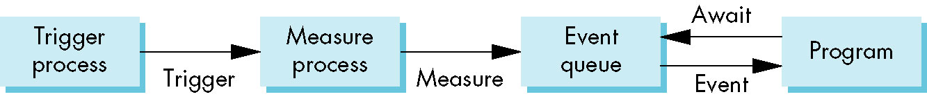
Input Devices (12)
    If there is an event in the queue, the program can look at the first event’s type and then decide what to do.
  Another approach is to associate a function called a callback with a specific type of event. We take this approach because it is the one currently used with the major window systems and has proved effective in client-server environments.
CG
115/11/08

Slide 18
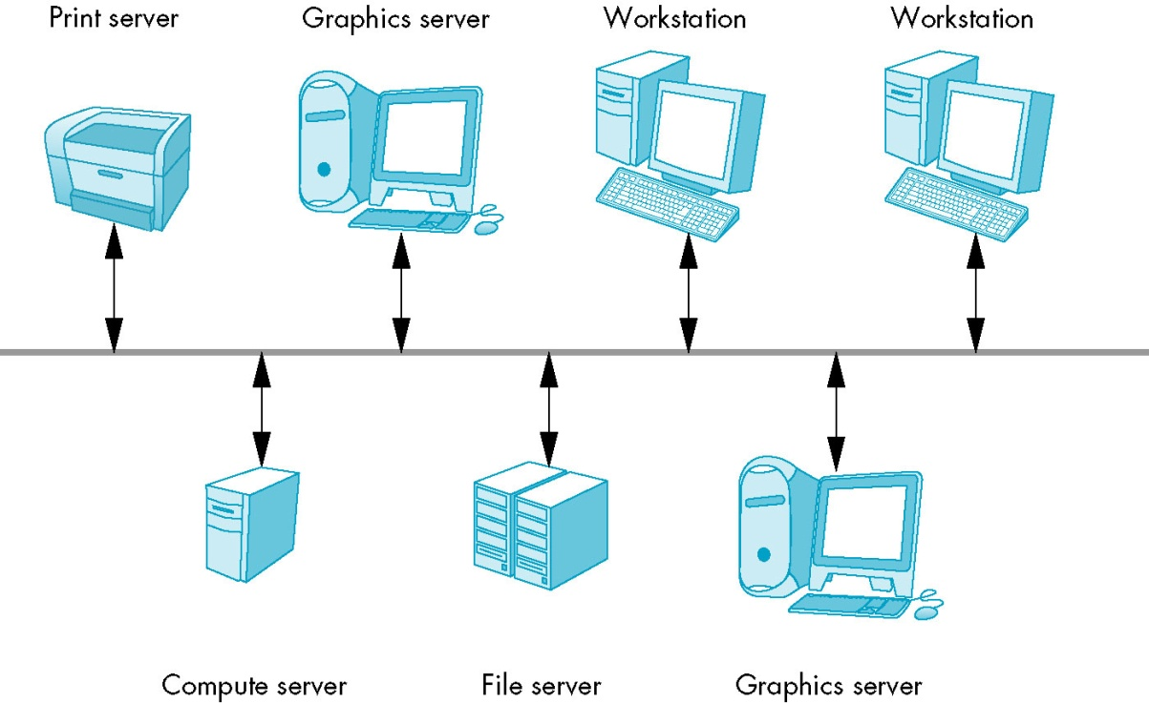
Input Devices (13)
Client and Servers
  If computer graphics is to be useful for a variety of real applications, it must function well in a world of distributed computing and networks.
  Users and user programs that make use of these services are clients or client programs.
  A workstation with a raster
  display, a keyboard, and a
  pointing device, such as a
  mouse, is a graphics server.
  These services are potentially
  available to clients on the
  network.
CG
115/11/08

Slide 19
Input Devices (14)
  Our OpenGL application programs are clients and use the graphics server.
CG
115/11/08

Slide 20
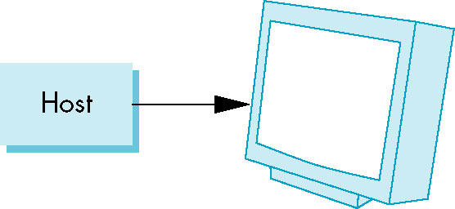
Display Lists (1)
Display lists illustrate how we can use clients and servers on a network to improve interactive graphics performance.
Display lists have their origins in the early days of computer graphics.
At the time (1960), computers were slow and expensive, so the cost of keeping even a simple display refreshed was prohibitive for all but a few applications.
The solution to this problem was to build a special-purpose computer, called display processor.
CG
115/11/08

Slide 21
Display Lists (2)
The user program was processed in the host computer, resulting in a compiled list of instructions that was then sent to the display processor, where the instructions were stored in a display memory as a display file, or display list.
Today, the display processor of old has become a graphics server, and the application program on the host computer has become a client.
The major bottleneck is no longer the rate at which we have to refresh the display, but rather the amount of traffic that passes between the client and server.
In addition, the use of special-purpose hardware now characterizes high-end systems.
CG
115/11/08

Slide 22
Display Lists (3)
We can send graphics entities to a display in one of two ways.
First, we can send the complete description of the objects to the graphics server.
  The typical geometric primitives, this transfer entails sending vertices, attributes, and primitive types.
  In immediate mode, primitive is sent to the server for possible display and no memory of it is retained in the system.
  The redisplay the primitive after a clearing of the screen, or in a new position after an interaction, the program must respecify the primitive an then must resend the information through the display process.
CG
115/11/08

Slide 23
Display Lists (4)
The second method is called retained mode graphics.
  The display list is stored in the server and redisplay by a simple function call issued from the client to the server.
  This mode allows much of the overhead in executing commands to be done once and have the results stored in the display list on the graphics server.
  A good numerical-processing computer that execute the client program and a special-purpose graphics computer for the server.
  In modern workstations that use commodity graphics cards in which the GPU carries out most rendering commands, there may not be a performance advantage in using display lists.
CG
115/11/08

Slide 24
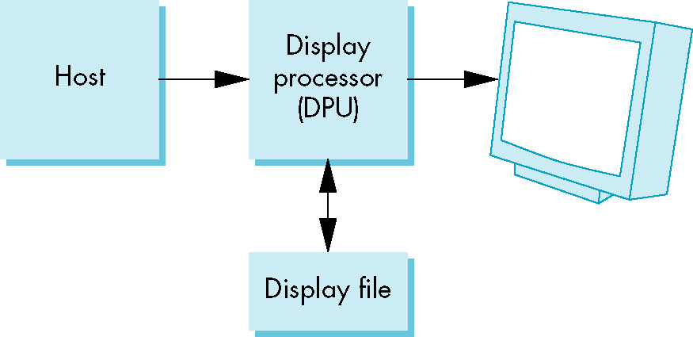
Display Lists (5)
Definition and Execution of Display Lists
  There must be a mechanism to define and manipulate them
  OpenGL has a small set of functions to manipulate display lists and places only a few restrictions on display list contents.
  Display lists are defined similarly to geometric primitives. There is a glNewList at the beginning and a glEndList at the end.
CG
115/11/08

Slide 25
Display Lists (6)
  Each display list must have a unique identifier- an integer that is usually macro defined in the C program by means of a #define directive to an appropriate name for the object in the list.
  #define BOX 1
  glNewList (BOX, GL_COMPILE);
  glBegin(GL_POLYGON)
  glColor3f(1.0, 0.0, 0.0);
  glVertex2f(-1.0, -1.0);
  glVertex2f(1.0, 1.0);
  glVertex2f(1.0, 1.0);
  glVertex2f(-1.0, 1.0);
  glEnd();
  glEndList();
CG
115/11/08

Slide 26
Display Lists (7)
  The flag GL_COMPILE tells the system to send the list to the server but not to display its contents. An immediate display by using the GL_COMPILE_AND_EXECUTE flag.
  Each time that we wish to draw the box on the server, we execute the function as follows:
  glCallList (BOX);
  The current state determines which transformations are applied to the primitives in the display list. We change the model-view and projection matrices between executions of the display list, the box will appear in different places or will no longer appear.
CG
115/11/08

Slide 27
Display Lists (8)
  glMatrixMode(GL_PROJECTION);
  for (i=1;i<5;i++)
  {
  glLoadIdentity();
  glOrtho2D(-2.0*i, 2.0*i , -2.0*i, 2.0*i);
  glCallList(BOX);
  }
  The glCallList is executed, the box is redrawn.
CG
115/11/08

Slide 28
Display Lists (9)
  The easiest safeguard is to use the matrix and attribute stacks provided by OpenGL. We can save the present values of attributes and matrices by placing or pushing them on the top of the appropriate stack. We can recover then later by removing or popping them from the stack.
glPushAttrib(GL_ALL_ATTRIB_BIT);
glPushMatrix();
glPopAttrib();
glPopMatrix();
CG
115/11/08

Slide 29
Display Lists (10)
  A few additional functions are available that make it easier to work with display lists.
  We can create multiple lists with consecutive identifiers more easily if we use the function glGenLists(number), which return the first integer (or base) if number consecutive integers that are unused labels.
  The function glCallLists allows us to execute multiple display lists with a single function call.
Text and Display Lists
  Suppose that we use a raster font in which each character is stored as an 8×13 pattern of bits. It takes 13 bytes to store each character.
CG
115/11/08

Slide 30
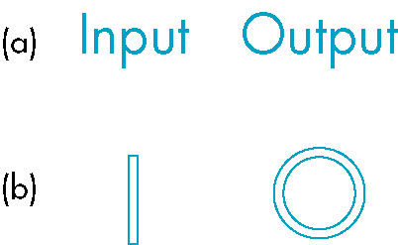
Display Lists (11)
  If we want to display a string by the most straightforward method, we can send each character to the server each time that we want it displayed.
  This transfer requires the movement of at least 13 bytes per character.
  If we define a stroke font using only line segment, each character can require a different number of lines.
  A more efficient strategy is to define the front
  once, using a display list for each character, and
  then to store the font on the server using these
  display lists.
CG
115/11/08

Slide 31
Display Lists (12)
  The basics of defining and displaying a character string (1 byte per character) using a stroke font and display lists provide a simple but important example of the use of display lists in OpenGL.
    First, we define a function OurFont (char c)
    Void OurFont (char c)
    { switch (c)
    {case ‘a’:
    …
    break;
    case ‘A’:
    …
    break;
    }
    }
CG
115/11/08

Slide 32
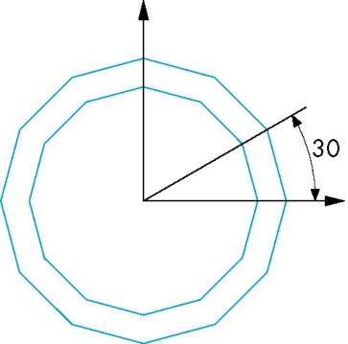
Display Lists (13)
  Within each case, we have to be careful about the spacing; each character in the sting must be displayed to the right of the previous character.
  We can use the translate function to get the desired spacing or shifting the vertex positions. Other characters can be defined in a similar manner.
  case’o’:
  glTranslatef(0.5, 0.5, 0.0);
  glBegin(GL_QUAD_STRIP);
  for(i=0;i<12;i++)
  { angle=3.14159/6.0*I;
  glVertex2f(0.4*cos(angle)+0.5;0.4*sin(angle)+0.5);
  glVertex2f(0.5*cos(angle)+0.5;0.5*sin(angle)+0.5);
  }
  glEnd();
  break;}
CG
115/11/08

Slide 33
Display Lists (14)
  Suppose that we want to generate 256-character set. The required code, using the OutFont function is as follows:
  base=glGenLists(256);
  for(i=0;i<256;i++)
  {
  glNewList(base+i, GL_COMPILE);
  OurFont(i);
  glEndList();
  }
  When we wish to use these display lists to draw individual characters, rather than offsetting the identifier of the display lists by base each time, we can set an offset as follows:
  glListBase(base);
CG
115/11/08

Slide 34
Display Lists (15)
  Our drawing of a string is accomplished in the server by the function call
  char *text_string;
  glCallLists((GLint) strlen(text_string), GL_BYTE, text_string);
Fonts in GLUT
  In general, we prefer to use an existing font rather than to define our own. GLUT provides a few raster and stroke fonts.
  We can access a single character from a monotype. GLUT_STROKE_MONO_ROMAN provides proportional spaced characters
  glutStrokeCharacter(GLUT_STROKE_MONO_ROMAN, int character);
CG
115/11/08

Slide 35
Display Lists (16)
  In addition, each invocation of glutStrokeCharacter includes a translation to the bottom right of the character’s box, to prepare for the next character.
  Raster and bitmap character are produced in a similar manner,
  glutBitmapCharacter(GLUT_BITMAP_8_By_13, int character);
  Positioning of bitmap characters is considerably simpler than the positioning of stroke characters is because bitmap characters are drawn directly in the frame buffer and are not subject to geometric transformation.
  If characters have different widths, we can use the glutBitmapWidth(font, char) function to return the width of a particular character.
CG
115/11/08

Slide 36
Display Lists and Modeling
Because display lists can call other display lists, they are powerful tools for building hierarchical models that can incorporate relationships among parts of a model.
#define EYE 1 #define FACE 2
glNewList(EYE); glNewList(FACE);
/*eye code*/ /*draw the outline*/
glEndList(); glTranslatef(…)
glCallList(EYE);
glTranslatef(…)
glCallList(EYE);
glTranslatef(…)
glCallList(NOSE);
glEndList();
CG
115/11/08

Slide 37
Programming Event-Driven Input (1)
In this section, we develop event-driven through a set of simple examples that use the callback mechanism.
Using the Pointing Device
  We start by altering the main function. (glutMainLoop)
  GLUT library recognizes a small set of events that is common to most window systems and is sufficient for developing basic interactive graphics programs.
  Two types of event are associated with the pointing device
  Move event is generated when the mouse is moved with one of the buttons pressed.
    if the mouse is moved without a button being held down, this event is called a passive move event.
CG
115/11/08

Slide 38
Programming Event-Driven Input (2)
    After a move event, the position of the mouse is made available to the application program.
    Mouse event occurs when one of the mouse button is either pressed or released.
    The information returned includes the button that generated the event, the state of the button after the event (up or down), and the position of the cursor tracking the mouse in window coordinates. (with the origin in the upper-left corner of the window)
  glutMouseFunc(mymouse);
  The mouse callback must have the form:
  void mymouse(int button, int state, int x, int y)
CG
115/11/08

Slide 39
Programming Event-Driven Input (3)
void mymouse (int button, int state, int x, int y)
{
if(button == GLUT_LEFT_BUTTON && state == GLUT_DOWN)
exit(0);
}
Example: we write a program to draw a small box at each location on the screen where the mouse cursor is located at the time that the left button is pressed. We use the middle button to terminate the program.
CG
115/11/08

Slide 40
Programming Event-Driven Input (4)
int main(int argc, char** argv)
{
glutInit(&argc,argv);
glutInitWindowSize(ww, wh);
glutInitDisplayMode (GLUT_SINGLE | GLUT_RGB);
glutCreateWindow("square");
myinit ();
glutReshapeFunc (myReshape);
glutMouseFunc (myMouse);
glutDisplayFunc(myDisplay);
glutMainLoop();
}
CG
115/11/08

Slide 41
Programming Event-Driven Input (5)
The reshape event is generated whenever the window is resized, such as by a user interaction. Because GLUT requires that all programs have a display callback, we must include this callback, although it can have a simple body.
void myDisplay ()
{
glClear (GL_COLOR_BUFFER_BIT);
}
CG
115/11/08

Slide 42
Programming Event-Driven Input (6)
The mouse callback:
void myMouse(int btn, int state, int x, int y)
{
if(btn==GLUT_LEFT_BUTTON && state== GLUT_DOWN)
drawSquare(x, y);
if(btn==GLUT_RIGHT_BUTTON && state==GLUT_DOWN)
exit(0);
}
CG
115/11/08

Slide 43
Programming Event-Driven Input (7)
Init function
/* globals */
GLsizei wh = 500, ww = 500; /* initial window size */
GLfloat size = 3.0; /* half side length of square */
void myInit(void)
{
glViewport(0,0,ww,wh);
glMatrixMode(GL_PROJECTION);
glLoadIdentity();
glOrtho2D(0.0, (GLdouble) ww , 0.0, (GLdouble) wh);
glMatrixMode(GL_MODELVIEW);
glClearColor (0.0, 0.0, 0.0, 1.0);
}
CG
115/11/08

Slide 44
Programming Event-Driven Input (8)
drawSquare function (top-left and bottom-left problems)
void drawSquare (int x, int y)
{
y=wh-y;
glBegin(GL_POLYGON);
glVertex2f(x+size, y+size);
glVertex2f(x-size, y+size);
glVertex2f(x-size, y-size);
glVertex2f(x+size, y-size);
glEnd();
glFlush();
}
CG
115/11/08

Slide 45
Programming Event-Driven Input (9)
Window Events
  Most windows systems allow a user to resize the window interactively, usually by using the mouse to drag a corner of the window to a new location. This event is an example of a window event.
  Void myReshape(GLsizei w, GLsizei h)
  {
  glMatrixMode(GL_PROJECTION);
  glLoadIdentity();
  gluOrtho2D(0.0, (GLdouble)w, 0.0, (GLdouble)h);
  glMatrixMode(GL_MODELVIEW);
  glLoadIdentity();
  glViewport(0, 0, w, h);
  ww=w;
  wh=h;
  }
CG
115/11/08

Slide 46
Programming Event-Driven Input (10)
  We could change the size of the squares to match the increase or decrease of the window size.
  Another simple change that we can make to our program is to have new squares generated as long as one of the mouse buttons is held down.
  glutMotionFunc(drawSquare);
  Each time the system senses motion, a new square is drawn.
Keyboard Events
  Keyboard events are generated when the mouse is in the window and one of the keys is pressed or released.
CG
115/11/08

Slide 47
Programming Event-Driven Input (11)
  The GLUT function glutKeyboardFunc is the callback for events generated by pressing a key, whereas glutKeyboardUpFunc is the callback for events generated by releasing a key.
  All the keyboard callbacks are registered in a single callback function.
  GLUT includes a function glutGetModifiers that enables the user to define action using the meta keys, such as the Control and Alt keys.
  glutKeyboardFunc(myKey);
  void myKey(unsigned char key, int x, int y)
  {
  if(key==‘q’ || key == ‘Q’)
  exit();
  }
CG
115/11/08

Slide 48
Programming Event-Driven Input (12)
The Display and Idle Callbacks
  glutDisplayFunc (myDisplay);
  It is invoked when GLUT determines that the window should be redisplayed. One such situation occurs when the window is opened initially; another happens after a resize event.
  The display callback can be used in other contexts, such as in animations, where various values defined in the program may change.
  We can also use GLUT to open multiple windows.
  Interactive and animation programs will contains many calls for the reexecution of the display function.
CG
115/11/08

Slide 49
Programming Event-Driven Input (13)
glutPostRedisplay();
Using this function, rather than invoking the display callback directly, avoids extra or unnecessary screen drawing by setting a flag inside GLUT’s main loop indicating that the display needs to be redrawn. At the end of each execution of the main loop, GLUT uses this flag to determine whether the display function will be executed.
Using glutPostRedisplay ensures that the display will be drawn only once each time the program go through the event loop. The idle callback is invoked when there are no other events.
CG
115/11/08

Slide 50
Programming Event-Driven Input (14)
Window Management
  GLUT also supports multiple windows and subwindows of a given window.
  We can open a second top-level window
  id= glutCreateWindow(“second window”);
  The returned integer value allows us to select this window as the current window into which objects will be rendered.
  glutSetWindow(id);
  We can make this window have properties different from those of other windows by invoking the glutInitDisplayMode before glutCreateWindow.
CG
115/11/08

Slide 51

Menus (1)
We could use the graphics primitives and the mouse callbacks to construct various graphics input devices. (as slidebar) However, much of the code would be tedious to develop.
GLUT provides one additional feature, pop-up menus, that we can use with the mouse to create sophisticated interactive applications.
Using menus involves taking a few simple steps.
  We must define the actions corresponding to each entry in the menu.
  We must link the menu to a particular mouse button.
  Finally, we must register a callback function for each menu.
CG
115/11/08

Slide 52
Menus (2)
glutCreateMenu(demo_menu);
glutAddMenuEntry(“quit”,1);
glutAddMenuEntry(“increase square size”, 2);
glutAddMenuEntry(“decrease square size”, 3);
glutAttachMenu(GLUT_RIGHT_BUTTON);
The function glutCreateMenu registers the callback function demo_
menu.
CG
115/11/08

Slide 53
Menus (3)
void demo_menu(int id)
{
switch (id)
{
case 1: exit(0);
break;
case 2: size = 2*size;
break;
case 3: if(size >1) size= size/2;
break;
}
glutPostRedisplay();
}
The call to glutPostRedisplay requests a redraw through the glutDisplayFunc callback, so that the screen is drawn again without the menu.
CG
115/11/08

Slide 54
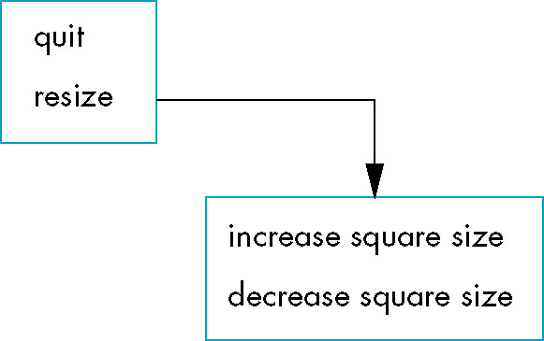
Menus (4)
GLUT also support hierarchical menus.
sub_menu = glutCreateMenu (size_menu);
glutAddMenuEntry(“Increase square size”, 2);
glutAddMenuEntry(“Decrease square size”, 3);
glutCreateMenu(top_menu);
glutAddMenuEntry(“Quit”, 1);
glutAddSubMenu(“Resize”, sub_menu);
glutAttachMenu(GLUT_RIGHT_BUTTON);
CG
115/11/08

Slide 55
Picking (1)
Picking is a logical input operation that allows the user to identify an object on the display.
Although the action f picking users the pointing device, the information that the users wants returned to the application program is not a position.
A pick device is considerably more difficult to implement on a modern system than is a locator.
One reason for the difficulty of picking in modern systems is the forward nature of the rendering pipeline.
CG
115/11/08

Slide 56
Picking (2)
There are least three ways to deal with this difficulty.
  One process, known as selection, involves adjusting the clipping region and viewport such that we can keep track of which primitives in a small clipping region are rendered into a region near the cursor.
    These primitives go into a hit list that can be examined later by the user program.
    OpenGL supports this approach.
  A simple approach is to use (axis-aligned) bounding boxes or extents for objects of interest.
    For a two-dimensional applications, it is relatively easy to determine the rectangle in screen coordinates that corresponds to a rectangle point in object or world coordinates.
    If the applications program maintains a simple data structure to relate objects and bounding boxes, approximate picking can be done within the application program.
CG
115/11/08

Slide 57
Picking (3)
  Another simple approach involves using the back buffer and an extra rendering. (double buffering)
Picking and Selection Mode
  The difficult problem in implementing packing within the OpenGL pipeline is that we cannot go backward directly from the position of the mouse to primitives that were rendered close to that point on the screen.
  OpenGL provides a somewhat complex process using a rendering mode called selection mode to do picking at the cost of an extra rendering each time that we do a pick.
  A number of steps and functions are required to do picking using selection mode.
CG
115/11/08

Slide 58
Picking (4)
  The function glRenderMode lets us select one of three modes:
    normal rendering to the color buffer (GL_RENDER)
    selection mode (GL_SELECT)
    feedback mode (GL_FEEDBACK). Feedback mode can be used to obtain a list of the primitives that were rendered.
  The return value from glRenderMode can be used to determine the number of primitives that were in the clipping volume.
  When we enter selection mode and render a scene, each primitive within the clipping volume generates a message called a hit that is stored in a buffer called the name stack.
  The information that we produce is called the hit list and can be examined after the rendering to obtain the information needed for picking.
CG
115/11/08

Slide 59
Picking (5)
void glSelectBuffer(GLsizei n, GLunint *buff)
Specifies the array buff of size n in which to place selection data.
void glInitNames()
This function initializes the name stack.
void glPushName(Gluint name)
This function pushes name on the name stack.
void glPopName()
This function pops the top name from the name stack.
CG
115/11/08

Slide 60
Picking (6)
void glLoadName(Gluint name)
This function replaces the top of the name stack with name.
  In general, each object that we wish to identify is a set of primitives to which we assign the same integer name.
  We cannot load a name onto an empty stack, so we usually enter an unused name onto the stack when we initialize it.
  glInitNames();
  glPushName(0);
  We typically use the mouse callback to enter selection mode an leave selection mode before the end of the mouse callback.
CG
115/11/08

Slide 61
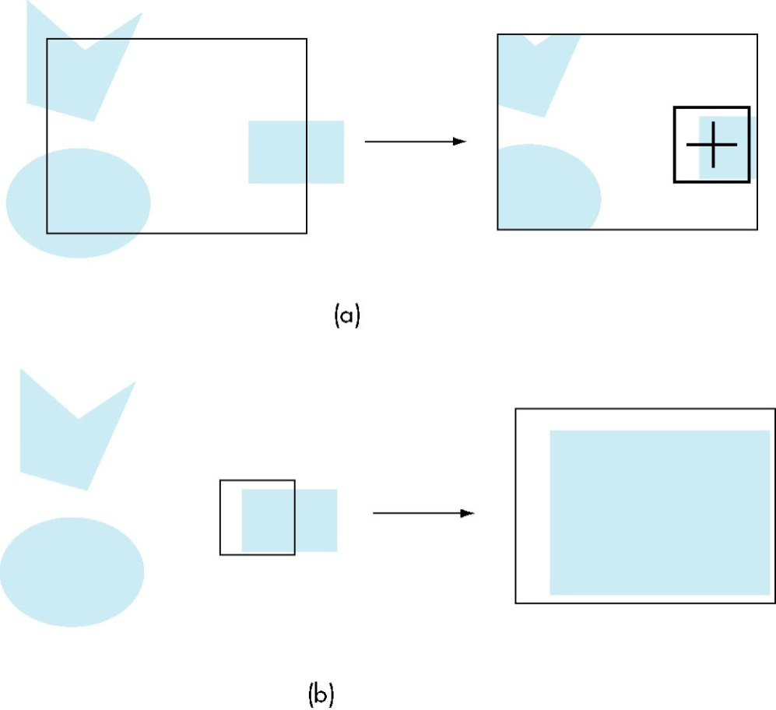
Picking (7)
  When we return to render mode, glRenderMode returns the number of hits that have been processed. We then examine the hit list.
  We can set the clipping volume in two ways.
    We can simply define a view volume
    through gluOrtho2D.
    We would probably first want to save
    the present clipping volume with a
    glPushMatrix.
  Suppose that we want all of objects
  that render into a small user define
  rectangle centered at the cursor.
CG
115/11/08

Slide 62
Picking (8)
    We can let OpenGL do this calculation for us through the GLU function gluPickMatrix, which is applied before glOrtho2D when we are in selection mode.
    gluPickMatrix (x, y, w, h, *vp)
    This function creates a projection matrix for picking that restricts drawing to a w×h area centered at (x, y) in window coordinates within the viewport vp.
    Assume that we have set up the viewing conditions for normal rendering during initialization or in the reshape callback, the mouse and display callbacks are of the following form:
CG
115/11/08

Slide 63
#define N 2 /*N×N pixels*/
void mouse(int button, int state, int x, int y)
{
GLuint nameBuffer[SIZE]; /*define SIZE elsewhere*/
GLint hits;
GLint viewport[4];
if (button == GLUT_LEFT_BUTTON && state == GLUT_DOWN)
{
/* initial the name stack*/
glInitNames();
glPushName(0);
glSelectBuffer (SIZE, namebuffer);
CG
115/11/08

Slide 64
/* set up viewing for selection mode*/
glGetIntegerv(GL_VIEWPORT, viewport);
glMatrixMode(GL_PROJECTION);
/* Save original viewing matrix*/
glPushMatrix();
glLoadIdentity();
/* N×N pick area around cursor */
/* must invert mouse y to get in world coords*/
glPickMatrix((GLdouble) x, (GLdouble) (viewport[3]-y), N, N, viewport);
/*some clipping window as in reshape callback*/
gluOrtho2D(xmin, xmax, ymin, ymax);
draw_objects(GL_SELECT);
glMatrixMode(GL_PROJECTION);
CG
115/11/08

Slide 65
/*restore viewing matrix*/
glPopMatrix();
glFlush();
/*return to normal render mode*/
hits= glRenderMode(GL_RENDER);
/*process hits from selection mode rendering*/
processHits(hits, nameBuff);
/*normal render*/
glutPostRedisplay();
}
}
CG
115/11/08

Slide 66
void display()
{
glClear(GL_COLOR_BUFFER_BIT);
draw_objects(GL_RENDER);
glFlush();
}
void drawObjects(GLenum mode)
{
if(mode==GL_SELECT)
glLoadName(1);
glColor3f(1.0, 0.0, 0.0);
glRectf(-0.5, -0.5, 1.0, 1.0);
if(mode==GL_SELECT)
glLoadName(2);
glColor3f(0.0, 0.0, 1.0);
glRectif(-1.0, -1.0, 0.5, 0.5); }
CG
115/11/08

Slide 67
Picking (9)
We can use glPushName to allow multiple names on the stack for a given hit.
For an object with multiple parts, all the parts that were close to the cursor have their names placed in the same stack.
We can use the processHits to print the information for the example.
CG
115/11/08

Slide 68
void processHits (GLint hits, GLuint buffer[])
{
unsigned int i, j;
GLuint names, *ptr;
printf ("hits = %d\n", hits);
ptr = (GLuint *) buffer;
/*loop over number of hits*/
for (i = 0; i < hits; i++)
{ /* for each hit */
names = *ptr;
/*skip over number of names and depths*/
ptr+=3;
CG
115/11/08

Slide 69
/*check each name in record*/
for (j = 0; j < names; j++)
{ /* for each name */
if(*ptr==1) printf ("red rectangle\n");
else printf ("blue rectangle\n");
ptr++;
}
printf ("\n");
}
}
CG
115/11/08

Slide 70
A Simple CAD Program (1)
Although these uses of CAD are wide-ranging, the graphics and interaction tend to have much in common, including the following:
  The use of multiple windows and viewports to display a variety of information.
  The ability to create, delete, and save user-defined objects.
  Multiple modes of operation employing menus, keyboard, and mouse.
OpenGL’s primary concern is rendering geometry.
CG
115/11/08

Slide 71
A Simple CAD Program (2)
We will develop a polygon-modeling application, Although it will be somewhat simple, it will illustrate many of the key features of a CAD application.
  Creation of polygons
  Deletion of polygons
  Selection and movement of polygons
These requirements imply that we need a data structure to support these operations and to provide storage of polygons so that they can be redisplayed.
CG
115/11/08

Slide 72
A Simple CAD Program (3)
We start by defining two globals to store the maximum number of polygons and the maximum number of vertices per polygon.
#define MAX_POLYGONS 10
#define MAX_VERTICES 10
Next, we define a data type to hold the data for a single polygon.
typedef struct polygon
{
int nvertices;
int x[MAX_VERTICES];
int y[MAX_VERTICES];
} polygon;
CG
115/11/08

Slide 73
A Simple CAD Program (4)
We cam allocate space for our polygons with the code:
polygon polygons[MAX_POLYGONS];
If we were to specify the first N polygons, we would display them
glClear(GL_COLOR_BUFFER_BIT);
for(i=0;i<N;i++)
{
glBegin(GL_POLYGON);
for(j=0;j<N;j++)
glVertex2i(polygons[i].x[j], polygons[i].y[j]);
glEnd();
}
CG
115/11/08

Slide 74
A Simple CAD Program (5)
We want to add new polygon and delete existing ones. We would like to assign a color for each polygon. We would also like to move a polygon about the display interactively.
typedef struct polygon
{
int color;
bool used;
int xmin, xmax, ymin, ymax;
float xc, yc;
int nvertices;
int x[MAX_VERTICES];
int y[MAX_VERTICES];
} polygon;
CG
115/11/08

Slide 75
A Simple CAD Program (6)
If the boolean used is true, then the polygon is defined. We can delete a polygon by setting the corresponding used value to false .
We have also added a center location that will be computed during creation of the polygon and will help in moving the polygon.
We use a bounding-box strategy to pick polygons, although we could use the more general selection mode strategy.
The bounding-box information is contained in xmin, xmax, ymin, ymax, which is set as the polygon is created.
CG
115/11/08

Slide 76
A Simple CAD Program (7)
To display all the polygons in polygons, first we check if each one is used and if it is we display it as before the color index for that polygon to assign a color.
for (i=0; i<MAX_POLYGONS; i++)
{
if(polygons[i].used)
{
glColor3fv(colors[polygons[i].color]);
glBegin(GL_POLYGON);
for(j=0;j<polygons[i].nvertices; j++)
glVertex2i(polygon[i].x[j], polygons[i].y[j]);
glEnd();
}}
CG
115/11/08

Slide 77
A Simple CAD Program (8)
We can now design the menus that will allow us to do the operations interactively.
c_menu=glutCreateMenu(color_menu);
glutAddMenuEntry("Black",0);
glutAddMenuEntry("Red",1);
glutAddMenuEntry("Green",2);
glutAddMenuEntry("Blue",3);
glutAddMenuEntry("Cyan",4);
glutAddMenuEntry("Magenta",5);
glutAddMenuEntry("Yellow",6);
glutAddMenuEntry("White",7);
CG
115/11/08

Slide 78
A Simple CAD Program (9)
glutCreateMenu(main_menu);
glutAddMenuEntry("new polygon", 1);
glutAddMenuEntry("end polygon", 2);
glutAddMenuEntry("delete polygon", 3);
glutAddMenuEntry("move polygon", 4);
glutAddMenuEntry("quit",5);
glutAddSubMenu("Colors", c_menu);
glutAttachMenu(GLUT_MIDDLE_BUTTON);
To implement functions that move or delete existing polygons, we must support some sort of picking action. We will add a few of our own state variables.
CG
115/11/08

Slide 79
A Simple CAD Program (10)
bool picking = FALSE; /* true while picking */
bool moving = FALSE; /* true while moving polygon */
int in_polygon = -1; /* not in any polygon */
int present_color = 0; /* default color */
The default color index is given by present_color. The variables picking and moving tell us if we are in the process of picking a polygon or moving an existing polygon, respectively.
The heart of the interactively is through the main_menu_callback,.
CG
115/11/08

Slide 80
A Simple CAD Program (11)
void main_menu(int index)
{
switch(index)
{
case(1):
{
/* create a new polygon */
break;
{
/* rest of cases*/
}}
CG
115/11/08

Slide 81
A Simple CAD Program (12)
To create a new polygon
case(1): /* create a new polygon */
{ moving = FALSE;
for(i=0; i<MAX_POLYGONS; i++)
if(polygons[i].used == FALSE) break;
if(i == MAX_POLYGONS)
{ printf("exceeded maximum number of polygons\n"); exit(0); }
polygons[i].color = present_color;
polygons[i].used = TRUE;
polygons[i].nvertices = 0;
in_polygon = i;
picking = FALSE;
break;
}
CG
115/11/08

Slide 82
A Simple CAD Program (13)
A user would then use the left mouse button to enter vertices.
if(btn==GLUT_LEFT_BUTTON && state==GLUT_DOWN &&!picking&&!moving)
{
if(in_polygon>=0)
{
if(polygons[in_polygon].nvertices == MAX_VERTICES)
{ printf("exceeds maximum number vertices\n"); exit(0);}
i = polygons[in_polygon].nvertices;
polygons[in_polygon].x[i] = x;
polygons[in_polygon].y[i] = y;
polygons[in_polygon].nvertices++;
}
}
CG
115/11/08

Slide 83
A Simple CAD Program (14)
The user returns to the menu to enter a polygon. Ending a polygon allows the program to compute the bounding box for the polygon and its center.
case(2): /* end polygon and find bounding box and center */
{
moving = FALSE;
if(in_polygon>=0)
{
polygons[in_polygon].xmax = polygons[in_polygon].xmin = polygons[in_polygon].x[0];
polygons[in_polygon].ymax = polygons[in_polygon].ymin = polygons[in_polygon].y[0];
polygons[in_polygon].xc = polygons[in_polygon].x[0];
polygons[in_polygon].yc = polygons[in_polygon].y[0];
CG
115/11/08

Slide 84
for(i=1;i<polygons[in_polygon].nvertices;i++)
{
if(polygons[in_polygon].x[i]<polygons[in_polygon].xmin)
polygons[in_polygon].xmin = polygons[in_polygon].x[i];
else if(polygons[in_polygon].x[i]>polygons[in_polygon].xmax)
polygons[in_polygon].xmax = polygons[in_polygon].x[i];
if(polygons[in_polygon].y[i]<polygons[in_polygon].ymin)
polygons[in_polygon].ymin = polygons[in_polygon].y[i];
else if(polygons[in_polygon].y[i]>polygons[in_polygon].ymax)
polygons[in_polygon].ymax = polygons[in_polygon].y[i];
polygons[in_polygon].xc += polygons[in_polygon].x[i];
polygons[in_polygon].yc += polygons[in_polygon].y[i];
}
polygons[in_polygon].xc = polygons[in_polygon].xc/polygons[in_polygon].nvertices;
polygons[in_polygon].yc = polygons[in_polygon].yc/polygons[in_polygon].nvertices;
}
in_polygon = -1;
glutPostRedisplay();
break; }
CG
115/11/08

Slide 85
A Simple CAD Program (15)
The other actions we consider require picking to find which polygon, if any, the mouse is over. We can use the a simple bounding-box strategy to write a function that returns the identifier of the polygon or –1 if the mouse is not inside the bounding box of any polygon.
CG
115/11/08

Slide 86
int pick_polygon(int x, int y)
{
int i;
for(i=0; i<MAX_POLYGONS; i++)
{
if(polygons[i].used)
if((x>=polygons[i].xmin)&&(x<=polygons[i].xmax)&&(y>=polygons[i].ymin)
&&(y<polygons[i].ymax))
{
in_polygon = i;
moving = TRUE;
return(i);
}
return(-1);
}
}
CG
115/11/08

Slide 87
A Simple CAD Program (16)
Deleting and moving polygons are dealt with in the mouse and motion callbacks, respectively, after the state flags are set in the menu callbacks.
case(3): /* set picking mode */
{
picking = TRUE;
moving = FALSE;
break;
}
case(4): /* set moving mode */
{
moving = TRUE;
break;
}
CG
115/11/08

Slide 88
A Simple CAD Program (17)
The mouse callback code to delete a polygon including the pick operation
if(btn==GLUT_LEFT_BUTTON && state==GLUT_DOWN &&picking&&!moving)
{
picking = FALSE;
moving = FALSE;
j = pick_polygon(x,y);
if(j >= 0)
{
polygons[j].used = FALSE;
in_polygon = -1;
glutPostRedisplay();
}
}
CG
115/11/08

Slide 89
A Simple CAD Program (18)
The motion callback checks the state and then moves the center of the selected polygon to follow the mouse.
void myMotion(int x, int y)
{
float dx, dy;
int i,j;
if(moving)
{
y = wh - y;
j = pick_polygon(x, y);
if(j<0) return;
dx = x - polygons[j].xc;
dy = y - polygons[j].yc;
CG
115/11/08

Slide 90
for(i = 0; i< polygons[j].nvertices; i++)
{
polygons[j].x[i] += dx;
polygons[j].y[i] += dy;
}
polygons[j].xc += dx;
polygons[j].yc += dy;
if(dx>0) polygons[j].xmax += dx;
else polygons[j].xmin += dx;
if(dy>0) polygons[j].ymax += dy;
else polygons[j].ymin += dy;
glutPostRedisplay();
}
}
CG
115/11/08

Slide 91
Building Interactive Models (1)
Suppose that we want to build a complex image using a set of predefined building blocks. These can be simple geometric shapes.
Each occurrence of one of the basic items is known as an instance.
Let’s start with a few simple building blocks: an equilateral triangle, a square, a horizontal line segment and a vertical line segment.
  We assume that each is defined with a simple size centered at the origin.
  We also assume that each is specified through some OpenGL code.
  We can get the interactivity through the menus and picking as with the polygon program
CG
115/11/08

Slide 92
Building Interactive Models (2)
First, we create a more general basic structure to hold the information needed to draw a single simple object.
typedef struct object
{
int type;
float x, y;
float color[3];
} object;
we reserve the type 0 to mean that an object no longer exists or alternately exists but should not be rendered.
CG
115/11/08

Slide 93
Building Interactive Models (3)
We can then store a set of 100 objects through an array called an instance table,
object table[100];
an index to the last object in the list
int last_object;
Suppose that the user indicates a square, we can assign type SQUARE
#define SQUARE 1;
CG
115/11/08

Slide 94
Building Interactive Models (4)
Once the user uses the menu to indicate the object type and its color and then uses the mouse to indicate where to place the object. The code to enter the information in the table:
table[last_object].type = SQUARE;
table[last_object].x = x0;
table[last_object].y = y0;
table[last_object].color[0]=red;
table[last_object].color[1]=green;
table[last_object].color[2]=blue;
last_object ++;
CG
115/11/08

Slide 95
Building Interactive Models (5)
We want to display all the objects:
for(i=0;i<last_object;i++)
{
switch(table[i].type)
{
case 0: break;
case 1:
{
glColor3fv(table[i].color);
triangle(table[i].x, table[i].y);
break;
}
/*others*/
}
}
CG
115/11/08

Slide 96
Building Interactive Models (6)
We might edit the table interactively to eliminate objects. We can use one of the picking methods. If we use the bounding box, we can start the implementation by adding two locations to the object structure that define the lower-left and upper-right corners.
Suppose that the users has indicated through a menu that she wishes to eliminate an object and uses the mouse to locate the object. The program can now search the table for the first object whose bounding box contains the object and set the type of this object to zero.
CG
115/11/08

Slide 97
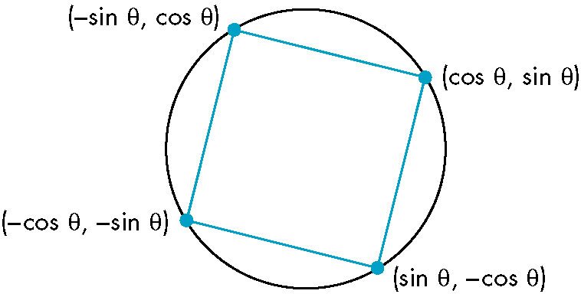
Animating Interactive Programs (1)
So far, the programs have been static.
Suppose that we want to create a picture in which one or more objects are changing or moving and thus their image must change.
The Rotating Square
  We can display this square.
  Suppose that we change the angle as
  the program is running, thus
  rotating the square about the
  origin. (use glutPostRedisplay)
CG
115/11/08

Slide 98
Animating Interactive Programs (2)
  Now suppose that we want to increase the angle by a fixed amount whenever nothing else is happening. We can use the idle callback for this operation.
  glutIdleFunc(idle);
  void idle()
  {
  theta +=2;
  if(theta >=360.0)
  theta-=360.0;
  glutPostRedisplay();
  }
CG
115/11/08

Slide 99
Animating Interactive Programs (3)
  We want to be able to turn on and turn off the rotation feature.
  glutMouseFunc(mouse);
  void mouse(int button, int state, int x, int y)
  {
  if (button==GLUT_LEFT_BUTTON && state=GLUT_DOWN)
  glutIdleFunc(idle);
  if (button==GLUT_MIDDLE_BUTTON && state=GLUT_DOWN)
  glutIdleFunc(NULL);
  }
CG
115/11/08

Slide 100
Animating Interactive Programs (4)
Double Buffering
  When we redisplay the contents of the frame buffer, we want to do so at a rate sufficiently high that we cannot notice the clearing and redrawing of the screen. (60 or 85 times per second)
  However, if we change the contents of the frame buffer during a refresh, we may see undesirable artifacts of how we generate the display. (complex object)
  Double buffering provides a solution to these problems. Suppose that we have two color buffers at our disposal called the front and back buffers. The front buffer is always the one display, whereas the back buffer is the one into which we draw. We can swap the front and the back buffers at will from the application program.
  glutSwapBuffers();
CG
115/11/08

Slide 101
Animating Interactive Programs (5)
  We set up double buffering by using the option GLUT_DOUBLE, instead of GLUT_SINGLE in glutInitDisplayMode.
  If we put our rendering into the display callback, the effect will be to update the back buffer. When the rendering is done, we execute glutSwapBuffers and the results will be display, thus guaranteeing a smooth display.
  Within the display callback, the first step is to clear the back buffer through glClear, and the final step is to invoke glutSwapBuffers.
glutInitDisplayMode(GLUT_RGB|GLUT_DOUBLE);
glutSwapBuffers();
CG
115/11/08

Slide 102
Animating Interactive Programs (6)
  Double buffering does not solve all the problems that we encounter with animate display. If the display is complex, we still may need multiple frames to draw the image into the frame buffer.
  The front and back buffers are color buffers that hold information that can be display on the screen. Normally, when we use double buffering, we would like OpenGL to draw into the back buffer, but we can control which color buffer is used.
  glutDrawBuffer(GL_BACK);
  glutDrawBuffer(GL_FRONT_AND_BACK);
CG
115/11/08

Slide 103
Animating Interactive Programs (7)
Using a Timer
  If we take a simple program such as the rotating cube and execute it on a fast GPU, the cube will be rendered thousands of times per second, we will see a blur on the display. We might want to control the speed of the rotation.
  There are least three approaches to the problem.
    We could use various timing mechanisms provides by libraries or the operating system to put delays into the application program.
    Another approach is provided by many commodity cards that allow users to set an option under which swapping of buffers is locked to the refresh rate.
    GLUT provides the third option through the timer function:
    glutTimerFunc(int display, void (*timer_func)(int), int value)
    Execution of this function starts a timer in the event loop at delays the event loop for delay milliseconds.
CG
115/11/08

Slide 104
Animating Interactive Programs (8)
GLUT allows only a single timer, using the recursive mechanism allows the program to execute the display callback at a fixed rate.
If we want it to execute at n frames per second, we can set the timer by registering the callback.
int n = 60;
glutTimerFunc(100, myTimer, n);
void myTimer(int v)
{
glutPostRedisplay();
glutTimerFunc(100/n, myTimer, v);
}
CG
115/11/08

Slide 105
Design of Interactive Programs (1)
Defining what characterizes a good interactive program is difficult, but recognizing and appreciating a good interactive program is easy.
The simple model of rendering geometric objects into a color buffer is not sufficient to support many of operations, as slidebars, etc.
The second example is rubberbanding, a technique used for displaying line segment that change as they are manipulated interactively.
CG
115/11/08

Slide 106
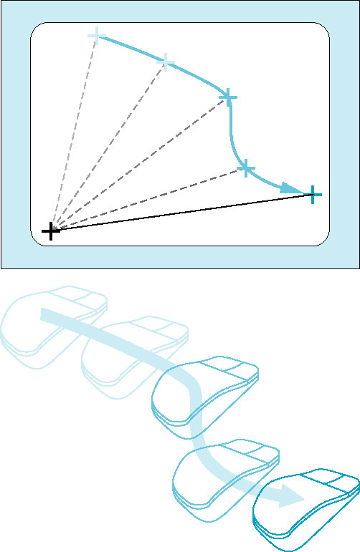
Design of Interactive Programs (2)
Note that before each new line segment appears, the previous line segment must be erased. Usually, the rubberbanding begins when a mouse button is pressed and continues until the button is released, at which time a final line segment is drawn.
We cannot implement this sequence of
operations using only what we have present
so far. One way to implement these operations
is to store the part of the display under the
menu and to copy it back when the menu is no
linger needed.
CG
115/11/08

Slide 107
Logic Operations (1)
When a program specifies a primitive that is visible, OpenGL renders into a set of colored pixels that are written into the present drawing buffer.
If we start with a color buffer that has been cleared to black and draw a blue rectangle that is 10×10 pixels, then 100 blue pixels are copied into the color buffer, replacing 100 black pixels. In this mode, called copy, or replacement mode.
CG
115/11/08

Slide 108
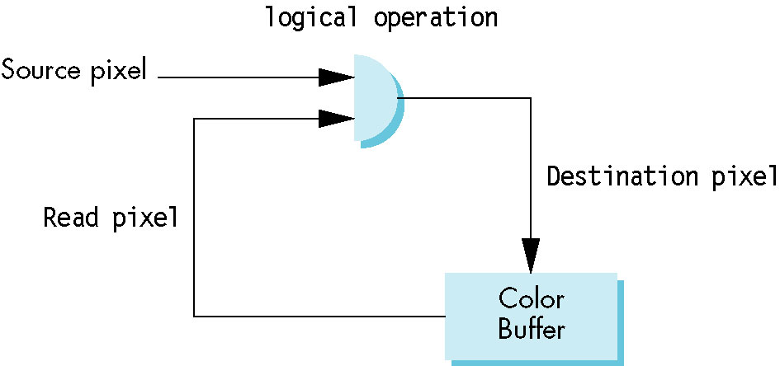
Logic Operations (2)
Consider the model shown in the figure, where we consider the writing of a single pixel into a color buffer. The pixel that we want to write is called the source pixel. The pixel in the drawing buffer that the source pixel will affect is called the destination pixel.
Here, we consider bitwise operations between the pixels. We are interested in two of these functions.
CG
115/11/08

Slide 109
Logic Operations (3)
The first is replacement mode, in which each bit in the source pixel replaces the corresponding bit in the destination pixel.
The second mode is the exclusive OR or XOR mode in which corresponding bits in each pixel are combined using the exclusive or logical operation.
OpenGL supports all 16 logic modes. Copy mode is the default.
glEnable(GL_COLOR_LOGIC_OP);
glLogicOp(GL_XOR);
CG
115/11/08

Slide 110
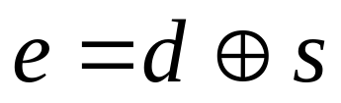
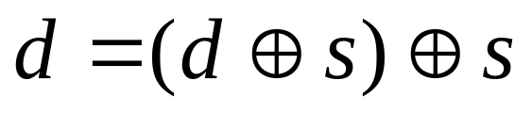
Logic Operations (4)
If s and d are corresponding bits in the source and destination pixels, we can denote the new destination bit as e, and it is given by
The most interesting property of the XOR operation is that if we apply it twice, we return to the original state.
CG
115/11/08

Slide 111
Logic Operations (5)
Drawing Erasable Lines
  Using the XOR drawing mode, we can draw erasable lines in a variety of ways.
  Support that the OpenGL window is 500×500 pixel and the clipping window is a unit square with the origin at the lower-left corner, We use the mouse to get the first endpoint and store this point in object coordinates.
  xm= x/500;
  ym= (500-y)/500;
  We then can get the second point and draw a line segement in XOR mode:
CG
115/11/08

Slide 112
Logic Operations (6)
xmm=x/500;
ymm=(500-y)/500;
glLogicOp(GL_XOR);
glBegin(GL_LINES)
glVertex2f(xm, ym);
glVertex2f(xmm, ymm);
glLogicOp(GL_COPY);
glEnd();
glFlush();
If we enter another point with the mouse, we first draw the same line in XOR mode and then draw a second line using the first endpoint and the mouse input.
CG
115/11/08

Slide 113
Logic Operations (7)
glLogicOp(GL_XOR);
glBegin(GL_LINES)
glVertex2f(xm, ym);
glVertex2f(xmm, ymm);
glEnd();
glFlush();
xmm=x/500;
ymm=(500-y)/500;
glLogicOp(GL_XOR);
glBegin(GL_LINES)
glVertex2f(xm, ym);
glVertex2f(xmm, ymm);
glLogicOp(GL_COPY);
glEnd();
glFlush();
CG
115/11/08

Slide 114
Logic Operations (8)
We can sequence these operations by using the right mouse button to enter these data and the left mouse button to indicate that we accept the line segment.
We can keep track of vertices by adding a counter, as in the paint program to store which endpoint is expected next.
We can get a rubberband line by using the same operations in conjunction with a motion callback.
CG
115/11/08

Slide 115
float xm, ym, xmm, ymm;
int first =0;
glutMouseFunc(mouse);
glutMotionFunc(move);
void mouse (int btn, int state, int x, int y)
{
if(btn==GLUT_LEFT_BUTTON && state=GLUT_DOWN)
{
xm=x/500;
ym=(500-y)/500;
glColor3d(0.0, 0.0, 0.0);
glLogicOp(GL_XOR);
first=0;
}
CG
115/11/08

Slide 116
if(btn==GLUT_LEFT_BUTTON && state=GLUT_UP)
{
glRectf(xm, ym, xmm, ymm);
glFlush();
glColor3f(0.0, 1.0, 0.0);
glLogicOp(GL_COPY);
xmm=x/500.0;
ymm=(500-y)/500.0;
glLogicOp(GL_COPY);
glRectf(xm, ym, xmm, ymm);
glFlush();
}
}
CG
115/11/08

Slide 117
Void move(int x, int y)
{
if (first ==1)
{
glRectf(xm, ym, xmm, ymm);
glFlush();
}
xmm=x/500.0;
ymm=(500-y)/500.0;
glRectf(xm, ym, xmm, ymm);
glFlush();
first =1;
}
CG
115/11/08

Slide 118
Color Cube in Chapter 4
#include<stdlib.h>
#include<stdio.h>
#include<time.h>
#include <GL/glut.h>
GLfloat vertices[][3] = {{-1.0,-1.0,-1.0},{1.0,-1.0,-1.0},
{1.0,1.0,-1.0}, {-1.0,1.0,-1.0}, {-1.0,-1.0,1.0},
{1.0,-1.0,1.0}, {1.0,1.0,1.0}, {-1.0,1.0,1.0}};
GLfloat normals[][3] = {{-1.0,-1.0,-1.0},{1.0,-1.0,-1.0},
{1.0,1.0,-1.0}, {-1.0,1.0,-1.0}, {-1.0,-1.0,1.0},
{1.0,-1.0,1.0}, {1.0,1.0,1.0}, {-1.0,1.0,1.0}};
GLfloat colors[][3] = {{0.0,0.0,0.0},{1.0,0.0,0.0},
{1.0,1.0,0.0}, {0.0,1.0,0.0}, {0.0,0.0,1.0},
{1.0,0.0,1.0}, {1.0,1.0,1.0}, {0.0,1.0,1.0}};
CG
115/11/08

Slide 119
void polygon(int a, int b, int c , int d)
{/* draw a polygon via list of vertices */
glBegin(GL_POLYGON);
glColor3fv(colors[a]);
glNormal3fv(normals[a]);
glVertex3fv(vertices[a]);
glColor3fv(colors[b]);
glNormal3fv(normals[b]);
glVertex3fv(vertices[b]);
glColor3fv(colors[c]);
glNormal3fv(normals[c]);
glVertex3fv(vertices[c]);
glColor3fv(colors[d]);
glNormal3fv(normals[d]);
glVertex3fv(vertices[d]);
glEnd(); }
CG
115/11/08

Slide 120
void colorcube(void)
{/* map vertices to faces */
polygon(0,3,2,1);
polygon(2,3,7,6);
polygon(0,4,7,3);
polygon(1,2,6,5);
polygon(4,5,6,7);
polygon(0,1,5,4);
}
static GLfloat theta[] = {0.0,0.0,0.0};
static GLint axis = 2;
CG
115/11/08

Slide 121
void display(void)
{
/* display callback, clear frame buffer and z buffer,
rotate cube and draw, swap buffers */
glClear(GL_COLOR_BUFFER_BIT | GL_DEPTH_BUFFER_BIT);
glLoadIdentity();
glRotatef(theta[0], 1.0, 0.0, 0.0);
glRotatef(theta[1], 0.0, 1.0, 0.0);
glRotatef(theta[2], 0.0, 0.0, 1.0);
colorcube();
glFlush();
glutSwapBuffers();
}
CG
115/11/08

Slide 122
void spinCube()
{/* Idle callback, spin cube 2 degrees about selected axis */
theta[axis] += 2.0;
if( theta[axis] > 360.0 ) theta[axis] -= 360.0;
/* display(); */
glutPostRedisplay();
}
void mouse(int btn, int state, int x, int y)
{/* mouse callback, selects an axis about which to rotate */
if(btn==GLUT_LEFT_BUTTON && state == GLUT_DOWN) axis = 0;
if(btn==GLUT_MIDDLE_BUTTON && state == GLUT_DOWN) axis = 1;
if(btn==GLUT_RIGHT_BUTTON && state == GLUT_DOWN) axis = 2;
}
CG
115/11/08

Slide 123
void myReshape(int w, int h)
{
glViewport(0, 0, w, h);
glMatrixMode(GL_PROJECTION);
glLoadIdentity();
if (w <= h)
glOrtho(-2.0, 2.0, -2.0 * (GLfloat) h / (GLfloat) w,
2.0 * (GLfloat) h / (GLfloat) w, -10.0, 10.0);
else
glOrtho(-2.0 * (GLfloat) w / (GLfloat) h,
2.0 * (GLfloat) w / (GLfloat) h, -2.0, 2.0, -10.0, 10.0);
glMatrixMode(GL_MODELVIEW);
}
CG
115/11/08

Slide 124
void main(int argc, char **argv)
{
glutInit(&argc, argv);
/* need both double buffering and z buffer */
glutInitDisplayMode(GLUT_DOUBLE | GLUT_RGB | GLUT_DEPTH);
glutInitWindowSize(500, 500);
glutCreateWindow("colorcube");
glutReshapeFunc(myReshape);
glutDisplayFunc(display);
glutIdleFunc(spinCube);
glutMouseFunc(mouse);
glEnable(GL_DEPTH_TEST); /* Enable hidden--surface--removal */
glutMainLoop();
}
CG
115/11/08

